Slide 1
Razvoj veb aplikacije učenja na daljinu u Java i Angular okruženjima
Kandidat: Jovan Lazić Broj indeksa: RN 114/20
Mentor rada: prof dr Milan Vidaković

Slide 2
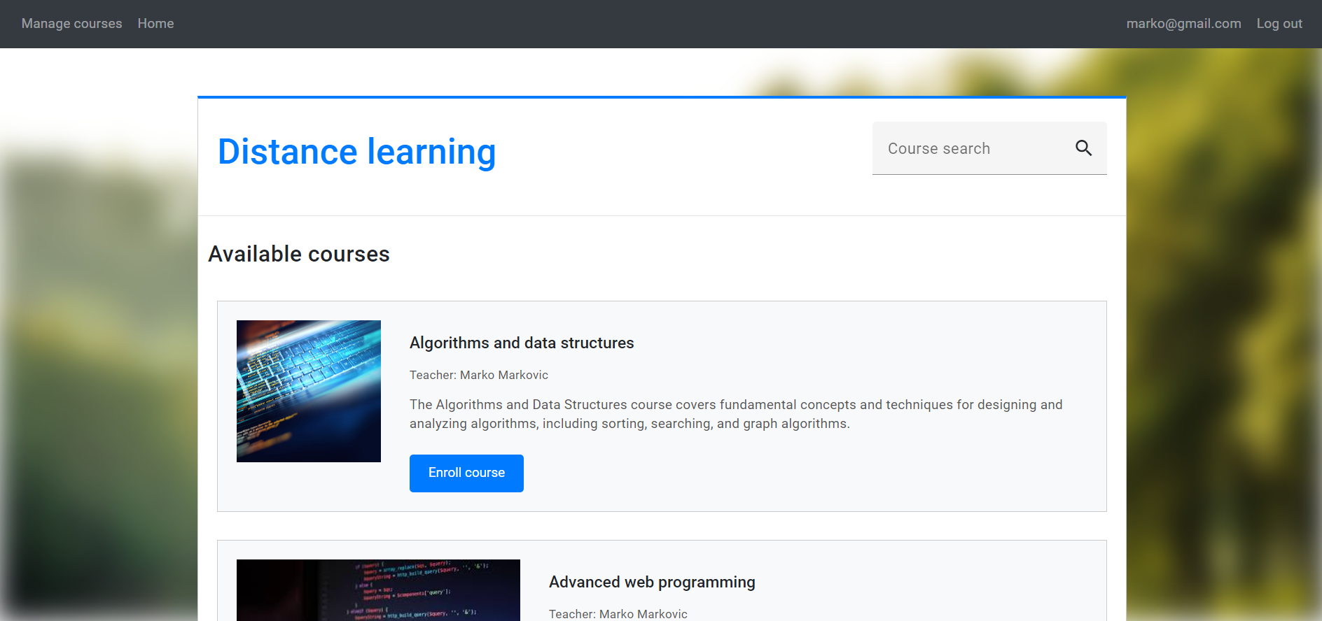
Aplikacija učenja na daljinu

Slide 3
Tehnologije
Backend
Java
Spring framework
Maven
PostgreSQL
Lombok
JSON Web Token
Frontend
TypeScript
Angular
Angular CLI

Slide 4
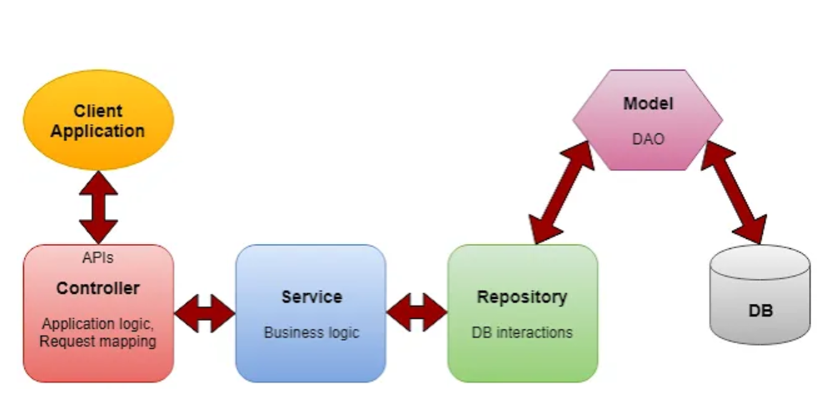
Arhitektura Java aplikacije

Slide 5
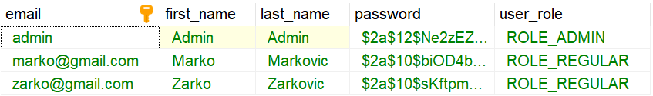
Implementacija korisnika i uloga u sistemu
@Entity public class AppUser { @Id private String email; private String firstName; private String lastName; private String password; @ManyToOne private Role role; }

Slide 6
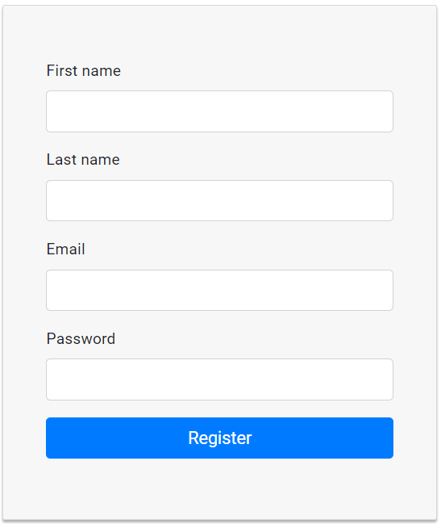
Registracija na klijentskoj strani
register(): void {
this.authService.register(this.fName, this.lName, this.email, this.password).subscribe({
next: () => {
window.alert("Registered successfully!")
this.router.navigate(["/login"])
},
error: (err) => {
window.alert(err.message)
}
})
}

Slide 7
Registraciju na serveru
@PostMapping("/registration") public ResponseEntity<User> registerUser(@RequestBody RegistrationRequest request) { return new ResponseEntity<>(authService.register(request), HttpStatus.CREATED); }
public User register(RegistrationRequest request) { if(userRepository.findById(request.email).isPresent()) { throw new UserAlreadyExistsException(request.email); }
User newUser = new User(request.firstName, request.lastName, request.email,
AppConfig.passwordEncoder().encode(request.password), Role.REGULAR); userRepository.save(newUser); return newUser; }

Slide 8

Kursevi
@Entity public class Course { @Id private String name; private String pictureURL; private String description; @ManyToOne
private AppUser teacher;
@OneToMany(mappedBy = "course") private List<Lecture> lectures; @OneToMany(mappedBy = "course", cascade = CascadeType.ALL) private List<Enrollment> enrollments = new ArrayList<>();
}

Slide 9
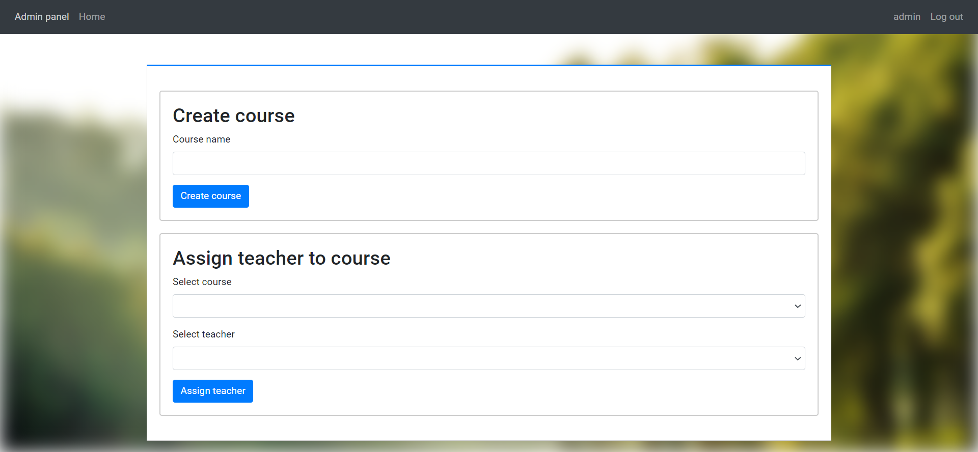
Kreiranje kurseva

Slide 10
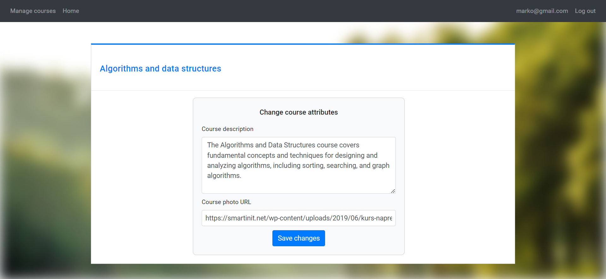
Promena atributa kursa

Slide 11

Lekcije
@Entity public class Lecture { @Id @GeneratedValue Long id; private String title; private String videoURL; private String data; @ManyToOne @JsonIgnore private Course course; @OneToOne private Test test; }

Slide 12
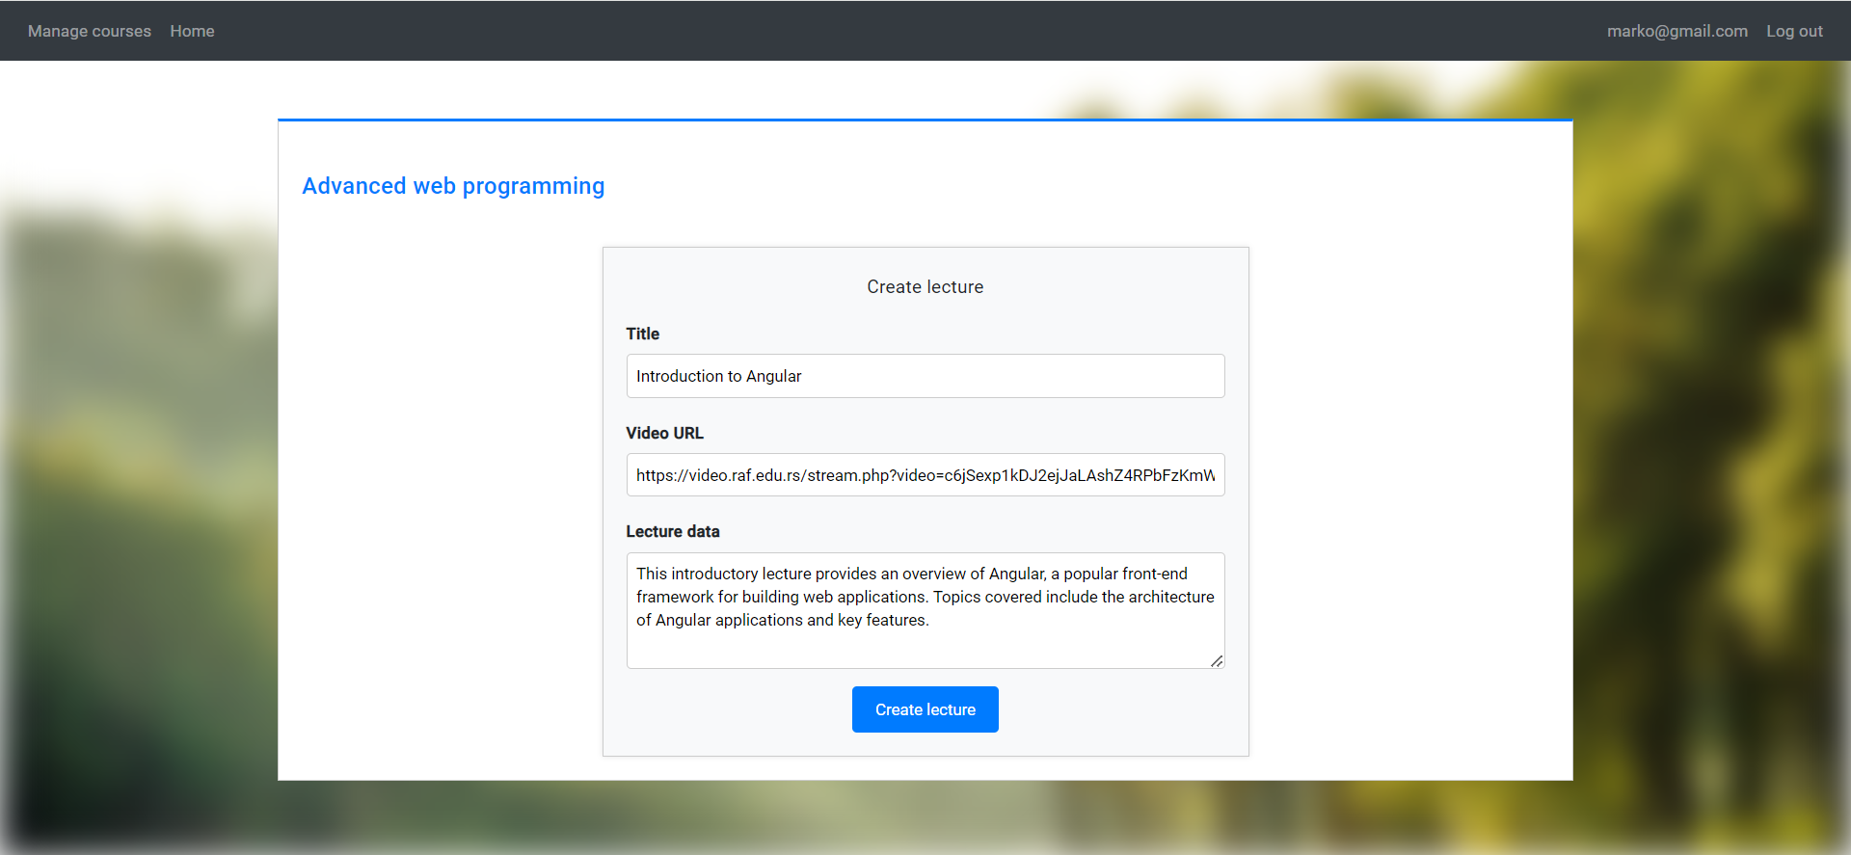
Komponenta za kreiranje lekcija

Slide 13
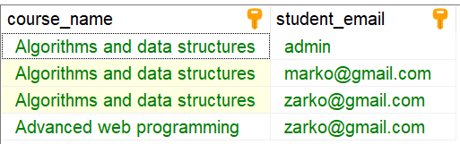
Prijavljivanje na kurs
@Entity public class Enrollment { @EmbeddedId private EnrollmentPK id; @ManyToOne @MapsId("course") private Course course; @ManyToOne @MapsId("student") private AppUser student; }

Slide 14

Testovi
@Entity public class Test { @Id @GeneratedValue private Long id; @Temporal(TemporalType.TIMESTAMP) private Date testStartDate; @OneToOne @JsonIgnore private Lecture lecture; @OneToMany(mappedBy = "test", cascade = CascadeType.ALL) private List<Question> questions = new ArrayList<>(); }

Slide 15
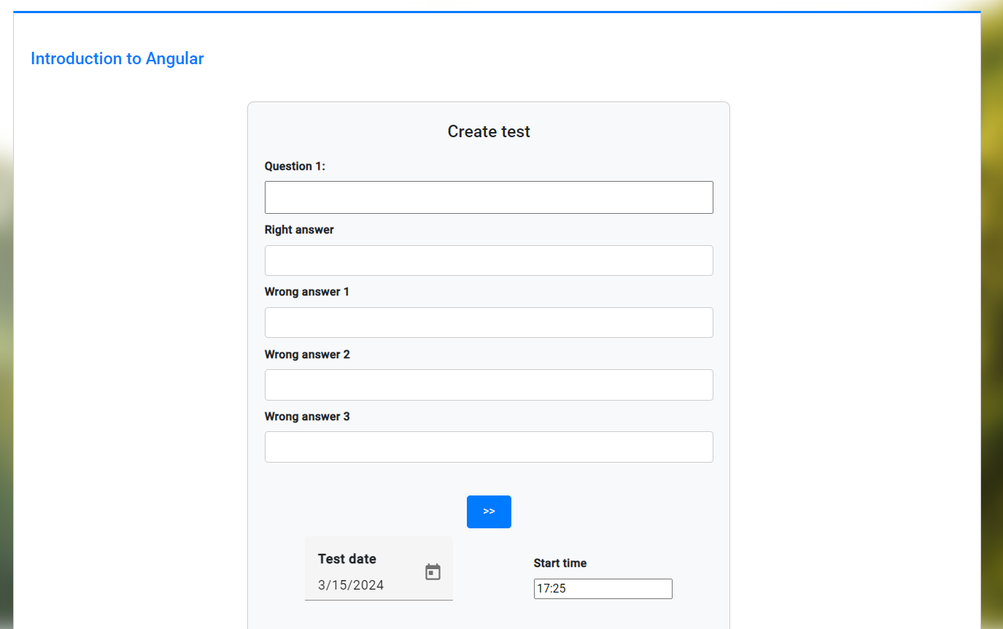
Komponenta kreiranja testa

Slide 16
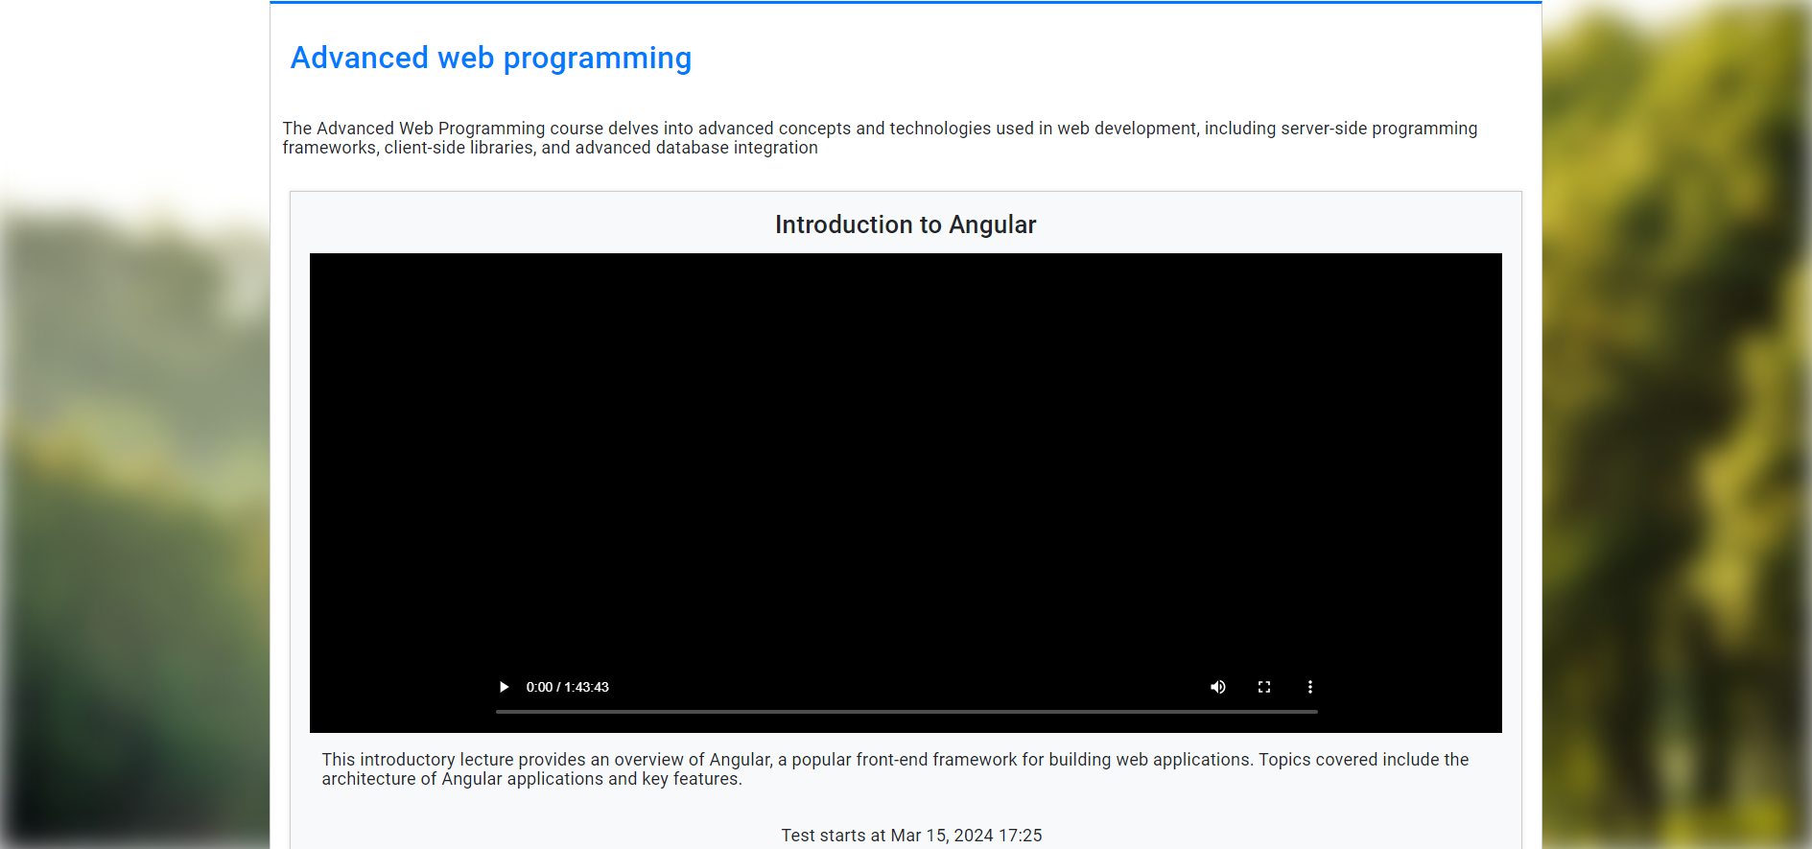
Pregled kursa

Slide 17
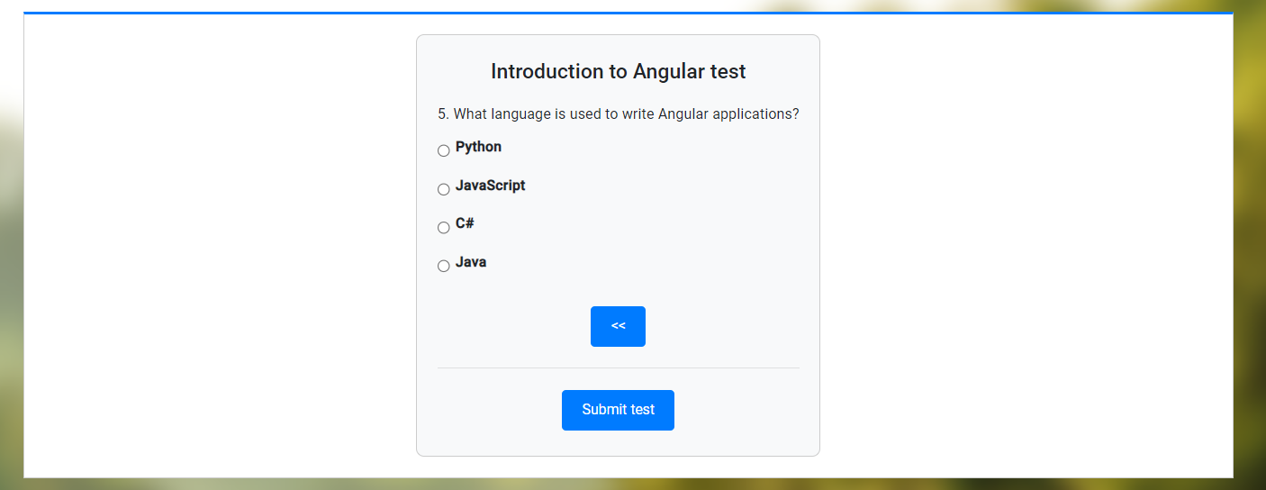
Izrada testova

Slide 18

Upis ocena
@Entity public class TestScore { @EmbeddedId private TestScorePK id; @ManyToOne @MapsId("student") AppUser student; @ManyToOne @MapsId("test") Test test; int score = 0; }

Slide 19
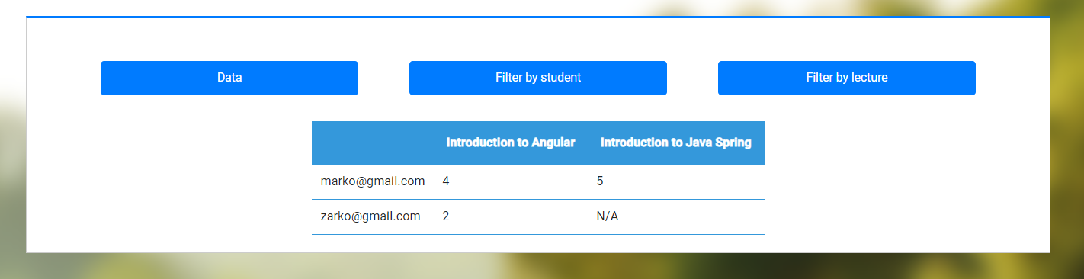
Prikaz testiranja

Slide 20
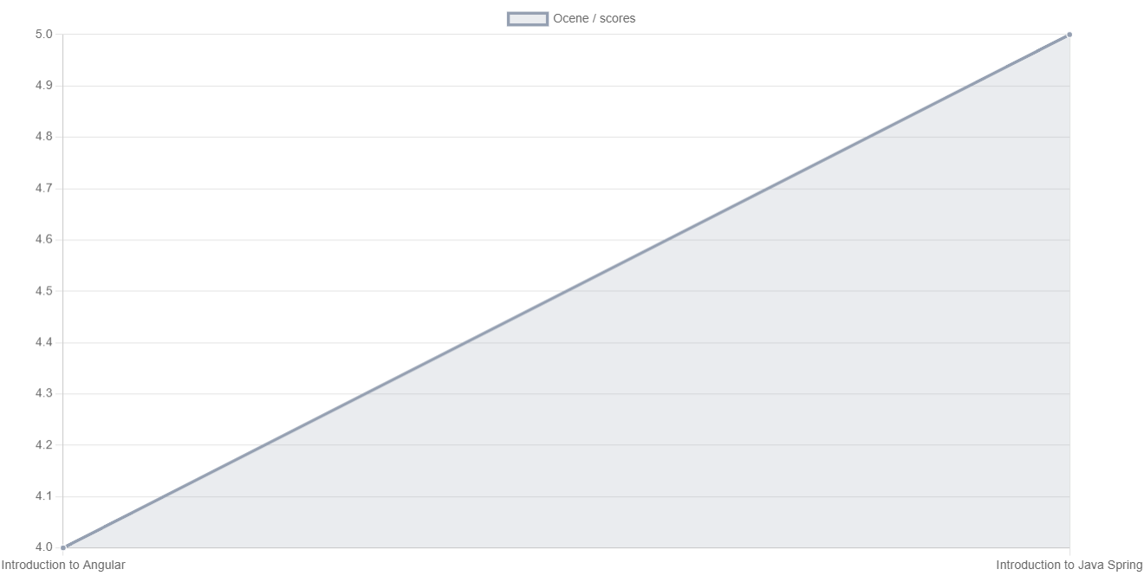
Prikaz po studentu

Slide 21
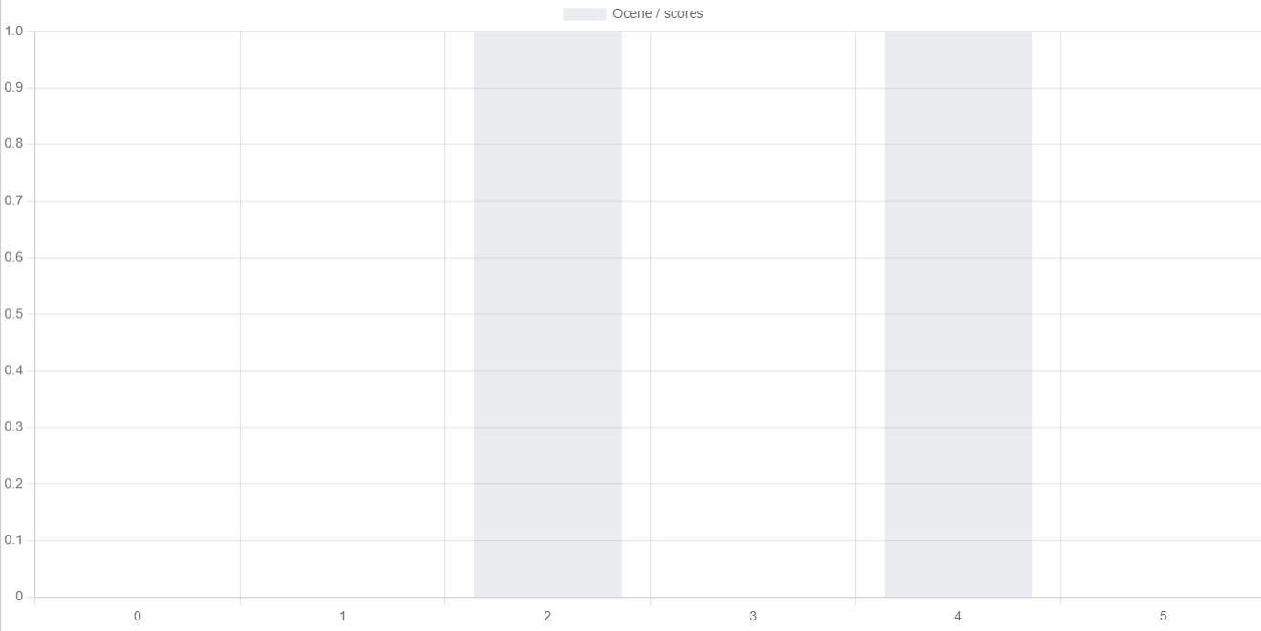
Prikaz po lekciji

Slide 22
Hvala na pažnji!

